Slide 1
Python for ML
By Ali Saeed

Slide 2
Sklearn library of Python
One hot encoder
Label Encoder
Accuracy Score
Train Test Split
Machine Learning models for NLP

Slide 3
One hot encoder
Encode categorical features as a one-hot numeric array.
This encoding is needed for feeding categorical data to many scikit-learn estimators, notably linear models and SVMs with the standard kernels.
Compute vocabulary and do one hot encoding

Slide 4
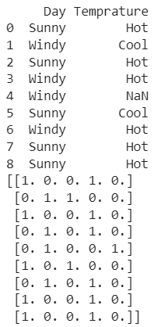
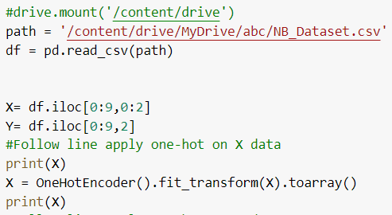
One hot encoder
from sklearn.preprocessing import OneHotEncoder
Input
Output

Slide 5
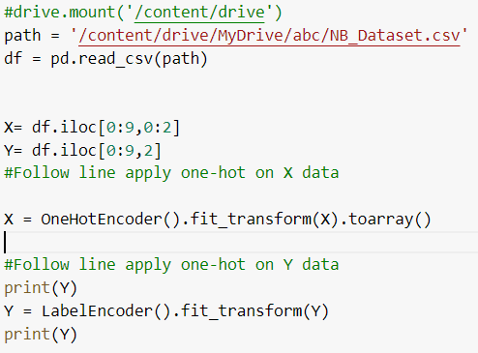
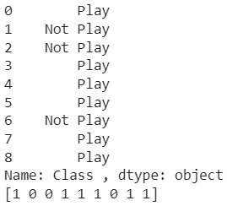
Label Encoder
from sklearn.preprocessing import LabelEncoder
Output
Input

Slide 6
Train- Test Split
from sklearn.model_selection import train_test_split
Split the data into train and test data with 33% test size and 67% train size
X_train: attributes of training data
X_test: attributes of test data
Y_train: Labels of training data
Y_test: Labels of test data

Slide 7
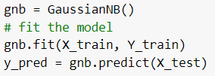
Model Prediction
from sklearn.naive_bayes import GaussianNB
Naïve Bayes model taring and prediction

Slide 8

Accuracy
from sklearn.metrics import accuracy_score
Accuracy = correct outcomes / total outcomes

Slide 9
ML Model Overview
Dataset (structured / unstructured)
Dataset Preprocessing / dataset Cleaning
Model Training
Accuracy reporting
Dataset
Preprocess
Model Training
Prediction and Accuracy reporting

Slide 10
Sklearn Classifiers
Naïve Bayes
from sklearn.naive_bayes import GaussianNB
GaussianNB()
SVM
from sklearn.svm import SVC
SVC()
KNN
from sklearn.neighbors import KNeighborsClassifier
KNeighborsClassifier(n_neighbors=3)

